Slide 1
XenAnalyticsTrans
Created on 24/09/2026

Slide 2
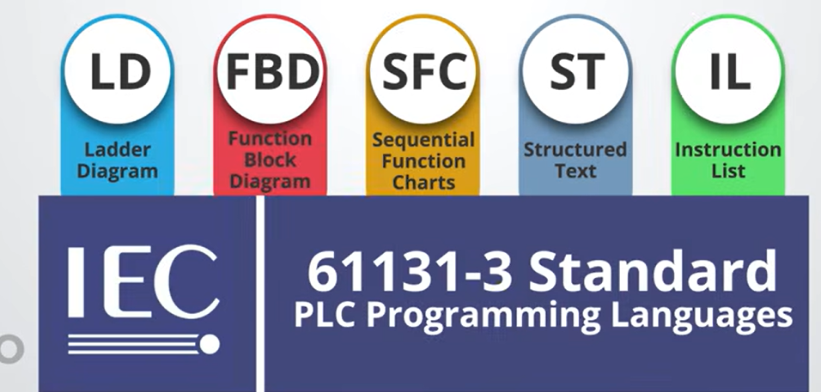

Slide 3
Siemen is using SCL (Structured Control Language)
ST is the official generic name defined by the international IEC 61131-3 standard. SCL is what Siemens calls its exact implementation of ST
ST (Structured Text) → IEC 61131-3 standard PLC programming language.
SCL (Structured Control Language) → Siemens' implementation/dialect of Structured Text, used in Siemens PLCs/TIA Portal.

Slide 4
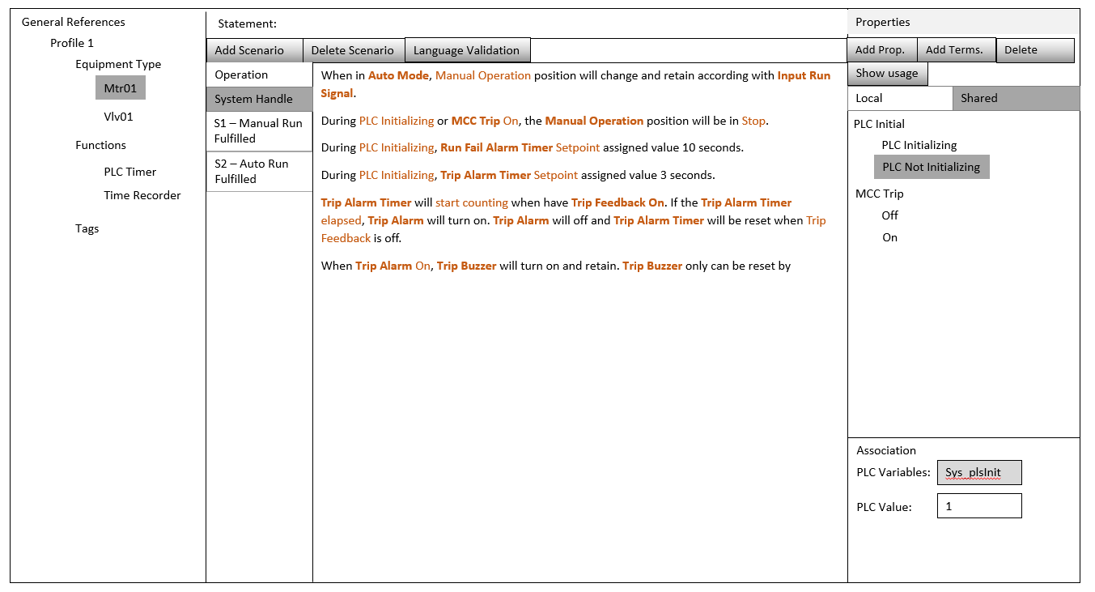

Slide 5
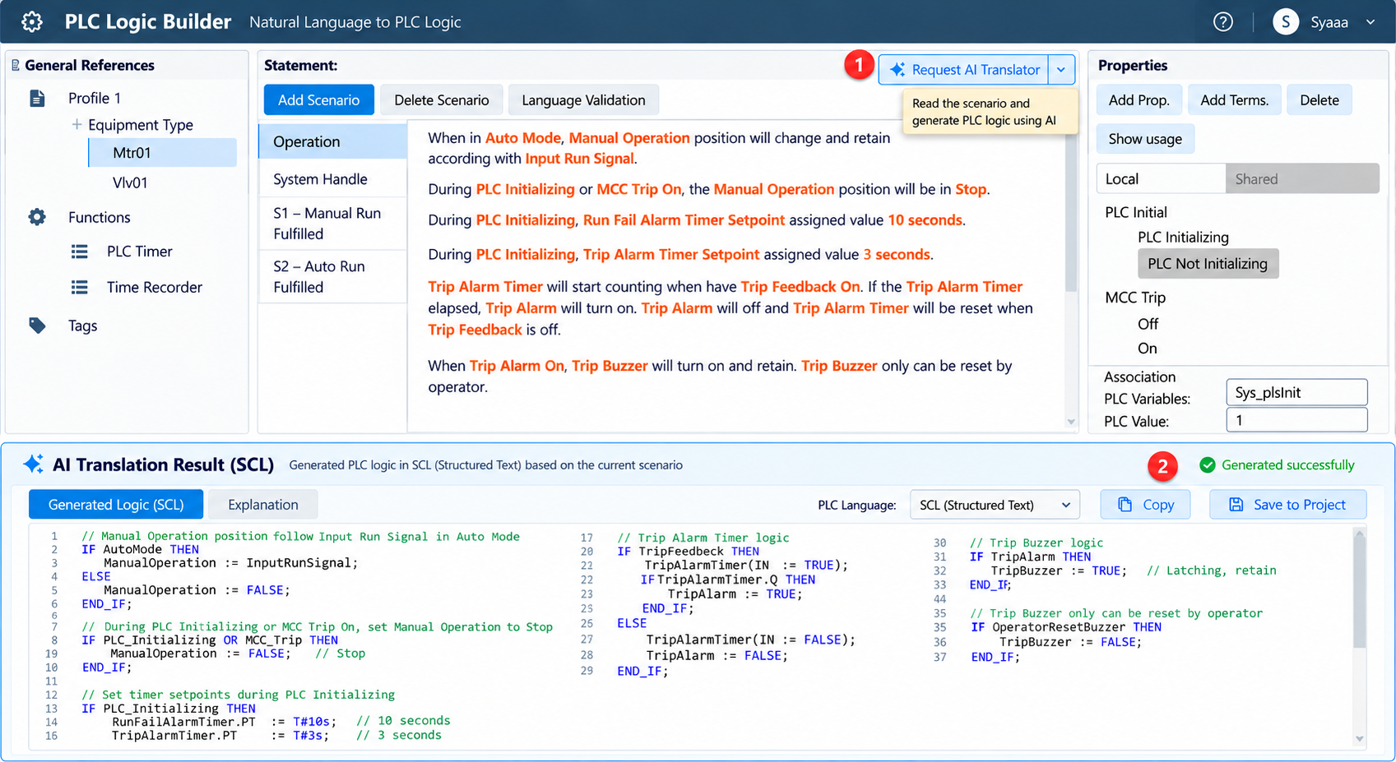
Gemini
Token
Function for API. Interact.

Slide 6
MODEL | CURRENT VERISON | ACCESIBLE VERSION | SOURCE
QWEN | Qwen3.7-Plus | Qwen3.8-Max | OpenRouter Alibaba Cloud – hanging in sign up
GEMINI | 3.6 Flash | 3.6 Flash
CHATGPT | GPT-6-astra | GPT-5.6 Luna.
CLAUDE | Opus 5 | Opus 5.5

Slide 7
